Slide 2
Youth Gun Violence Reduction Agenda
Time | Duration | Topic
1:30 pm – 1:45 pm | 15 minutes | Purpose of Meeting December 13, 2023 Call to Action – refresher
1:45 – 2 pm | 15 minutes | Attendee Introductions Name Organization Youth-Serving Focus
2 – 2:30 pm | 30 minutes | Strategic Marketing Plan Review
2:30 – 3:15 pm | 45 minutes | Marketing Exercise: #YGVR Brand & Provider Directory Survey
3:15 – 3:30 pm | 15 minutes | Strategic Marketing Plan Next Steps
3:30 – 4 pm | 30 minutes | Firearms Dashboard & Firearms Safety Information
4 – 4:15 pm | 15 minutes | Marketing Exercise: Brainstorm – Youth Participation Marketing & Design Information Sharing
4:15 – 4:30 pm | 15 minutes | Wrap-up

Slide 3
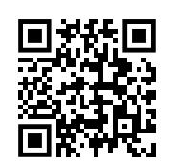
Purpose of Meeting
Objectives: 1. Understand the three components of the Strategic Marketing Plan.
2. Call to Action for Provider Directory Survey responses.
December 2023 Call to Action Refresher: Visual Summation
1. National Medical Association Council on Violence Prevention
2. Stop the Bleed
Access all resources at: https://marionhealth.org/call-to-action/

Slide 4
Stop the Bleed
Cardiopulmonary Resuscitation
Trauma-Informed Care
Evidence-Based

Slide 6
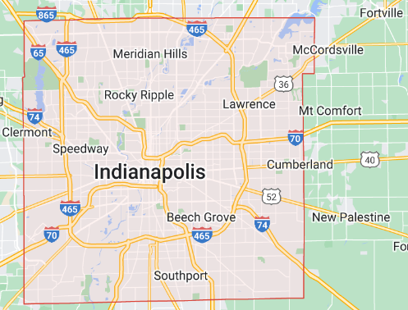
Attendee Introductions
First & Last Name
Organization or Program
Youth-serving focus
Service Area

Slide 7
Strategic Marketing Plan
1
Provider Directory
A searchable directory of Providers defined as Providers-Organizations, Providers-Programs, and Providers-Individuals that provide service and activities pertaining to the reduction of fire arm access in youth and families and services and support for the aftermath of a violent gun incident.
Provider Directory Survey
Provider Directory Map by Neighborhood
Provider Directory Database
2
Community Stories
A video-blog of stories by neighborhood representing all 9 townships + Beech Grove, Speedway, City of Lawrence capturing personas (shooter, victim, bystander, concerned family/friends) of gun violence.
Community Storytellers
Empathy for Personas
Digital History of Gun Violence
3
Resource Hub
A digital resource hub connecting Providers, Programs, Partners, and Survivors, Youth Workers, and Families to continuous mental health and supportive services post violent gun incident
Trauma Survivor Resource Hub
Youth Worker Resource Hub
Family Resource Hub
Provider Connect

Slide 8
Marketing Exercise: What’s in a name? Youth Gun Violence Reduction

Slide 9
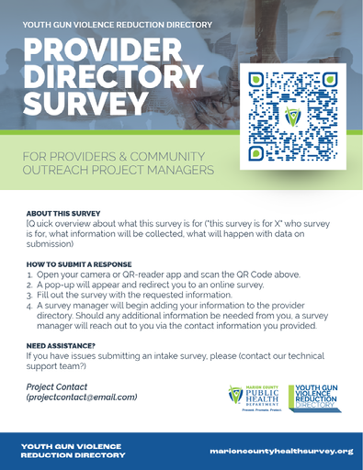
Marketing Exercise: Provider Directory Survey Feedback
Assess: Questions for Clarity
Assess: Questions for Cultural Competency
Review: Additional Data Collection Needs
Recommend: Survey distribution methods

Slide 11
Strategic Marketing Plan – Next Actions
1
Provider Directory
A searchable directory of Providers defined as Providers-Organizations, Providers-Programs, and Providers-Individuals that provide service and activities pertaining to the reduction of fire arm access in youth and families and services and support for the aftermath of a violent gun incident.
Provider Directory Survey
Provider Directory Map by Neighborhood
Provider Directory Database
2
Community Stories
A video-blog of stories by neighborhood representing all 9 townships + Beech Grove, Speedway, City of Lawrence capturing personas (shooter, victim, bystander, concerned family/friends) of gun violence.
Community Storytellers
Empathy for Personas
Digital History of Gun Violence
3
Resource Hub
A digital resource hub connecting Providers, Programs, Partners, and Survivors, Youth Workers, and Families to continuous mental health and supportive services post violent gun incident
Trauma Survivor Resource Hub
Youth Worker Resource Hub
Family Resource Hub
Provider Connect

Slide 12
Strategic Marketing Plan – Next Meeting
1
Provider Directory
A searchable directory of Providers defined as Providers-Organizations, Providers-Programs, and Providers-Individuals that provide service and activities pertaining to the reduction of fire arm access in youth and families and services and support for the aftermath of a violent gun incident.
Provider Directory Survey
Provider Directory Map by Neighborhood
Provider Directory Database
2
Community Stories
A video-blog of stories by neighborhood representing all 9 townships + Beech Grove, Speedway, City of Lawrence capturing personas (shooter, victim, bystander, concerned family/friends) of gun violence.
Community Storytellers
Empathy for Personas
Digital History of Gun Violence
3
Resource Hub
A digital resource hub connecting Providers, Programs, Partners, and Survivors, Youth Workers, and Families to continuous mental health and supportive services post violent gun incident
Trauma Survivor Resource Hub
Youth Worker Resource Hub
Family Resource Hub
Provider Connect

Slide 13
1 Firearms Dashboard
2 Firearms Safety Info

Slide 14
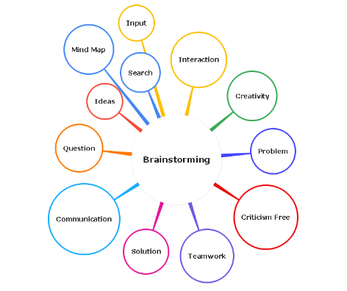
YOUTH
Participation

Slide 15
To Do List
1. Complete Provider Directory Survey
Digitally at: https://techserv.qualtrics.com/jfe/form/SV_6X24LjME9Wa9RpI
Print version provided in meeting – hand in to Deb Lu, Community Development Project Manager.
Need an interview to complete the survey? Schedule with Deb.
Share survey with partners.
2. Attend Next Meeting

