Slide 1
Thursday, November 7, 2024 • 6:00-8:30 P.M.
Martin University • Hardin Gathertorium
2186 N. Sherman Dr., Indianapolis, IN 46218

Slide 2
Youth Gun Violence Reduction Agenda
Time | Duration | Topic
6:00 pm – 6:30 pm | 30 minutes | Registration/Sign-In Dinner Served
6:30 – 7:30 pm | 60 minutes | Strategic Marketing Workshop Disarm Hate, Arm Love art initiative review Logo Competition Winner Announcement Presentation of Community Resource Directory Screening of Spotlight Organization Video
7:30 – 8:00 pm | 30 minutes | Tabletop Discussion and Feedback Slido Survey – Live Polling Open Floor for Feedback
8:00 – 8:20 pm | 20 minutes | Health First Indiana Funding Q&A
8:20 – 8:30 pm | 10 minutes | Wrap-up

Slide 3
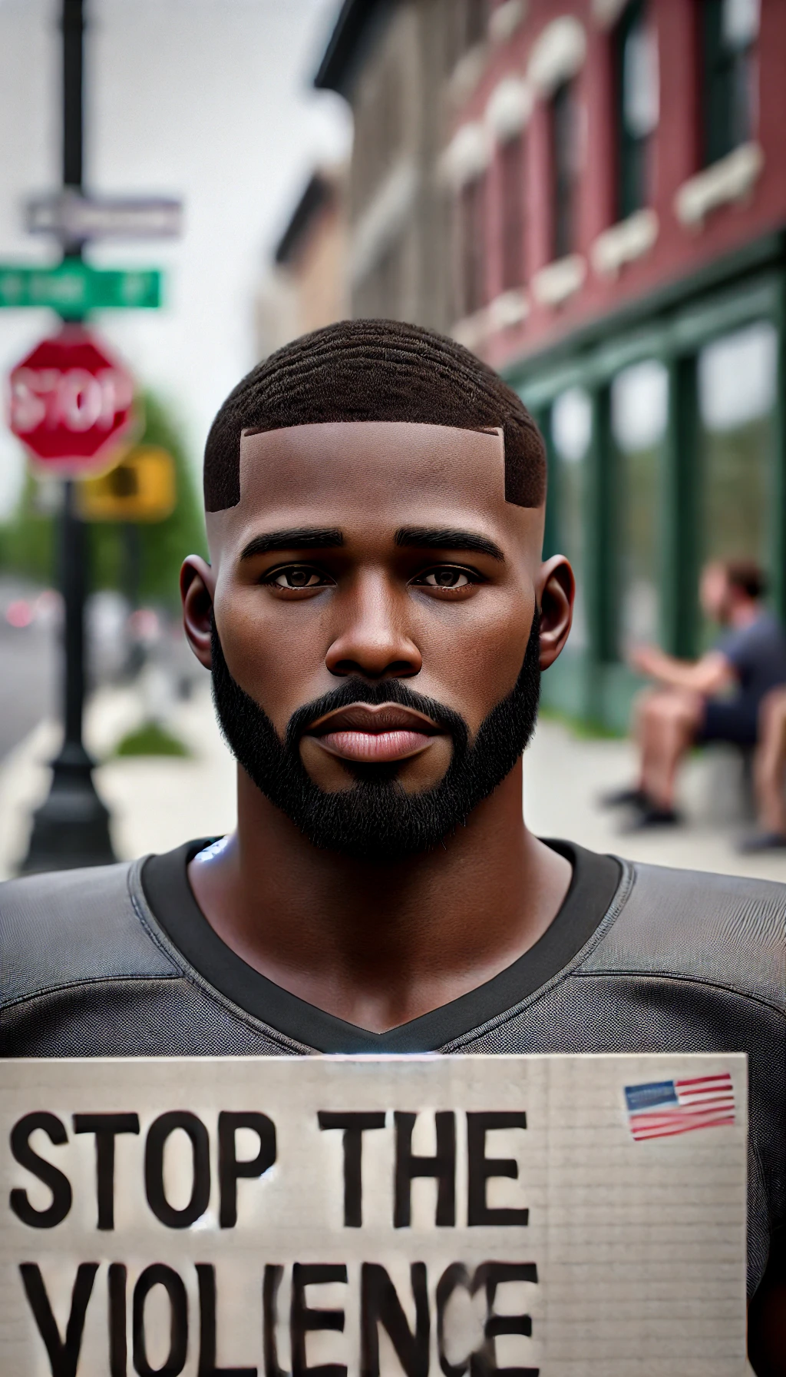
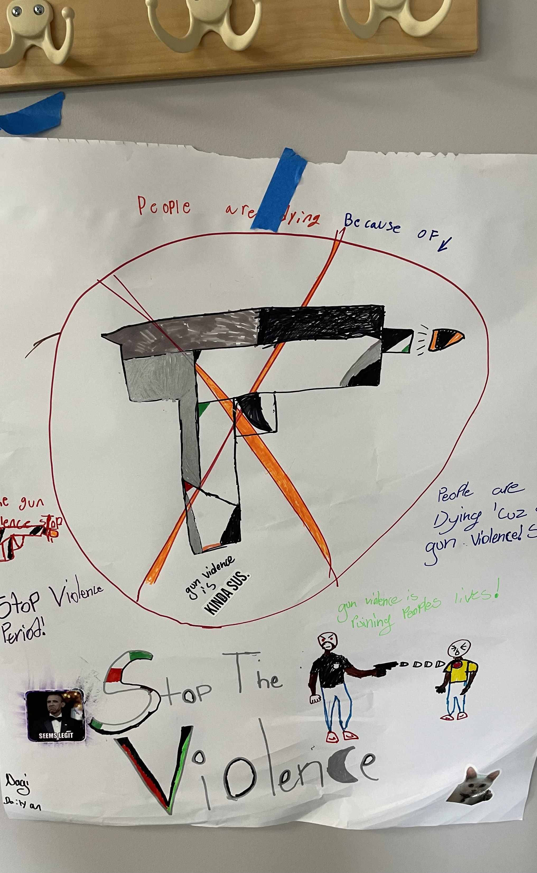
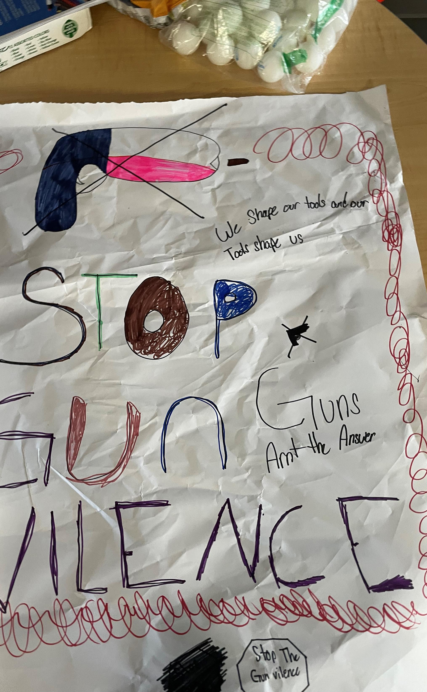
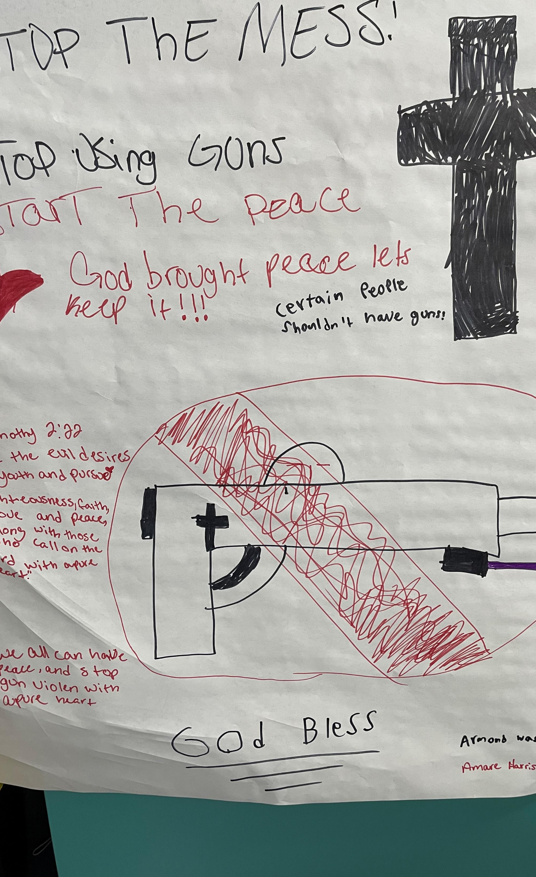
Disarm Hate, Arm Love art initiative

Slide 5
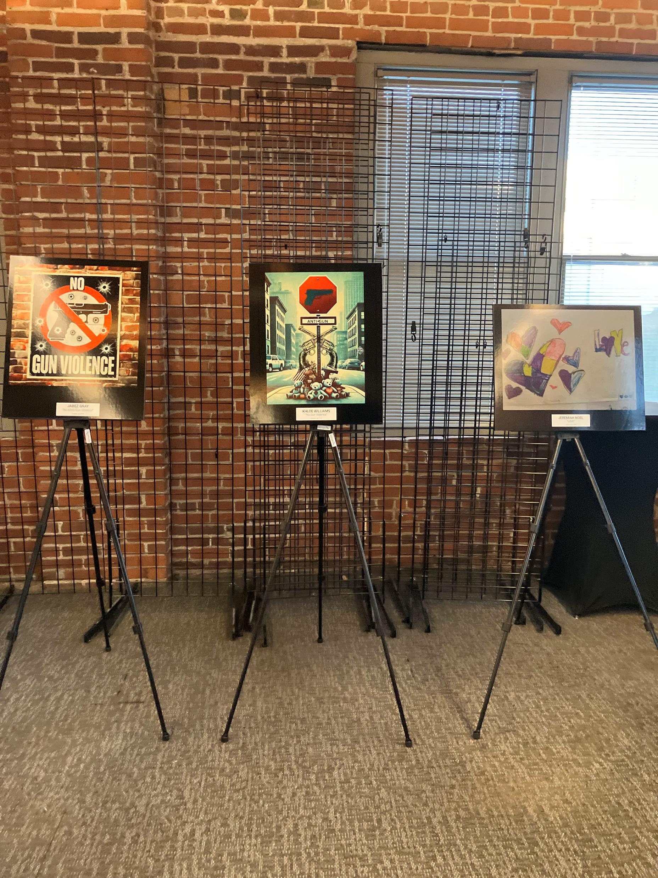
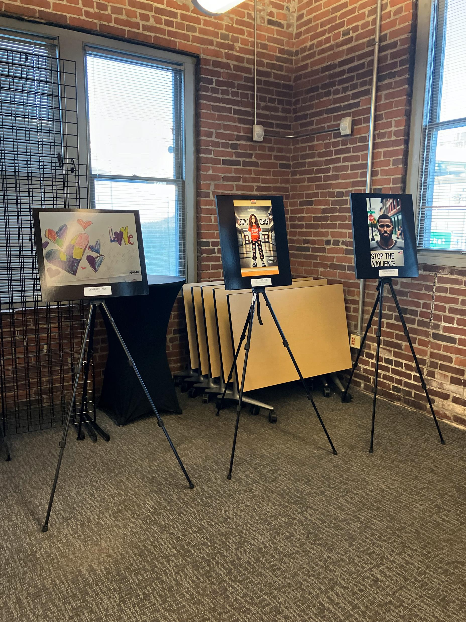
Indy Peace
National Office of Violence Prevention Network (NOVPN) Midwest Conference
INSPIRE Music Collective Panel

Slide 6
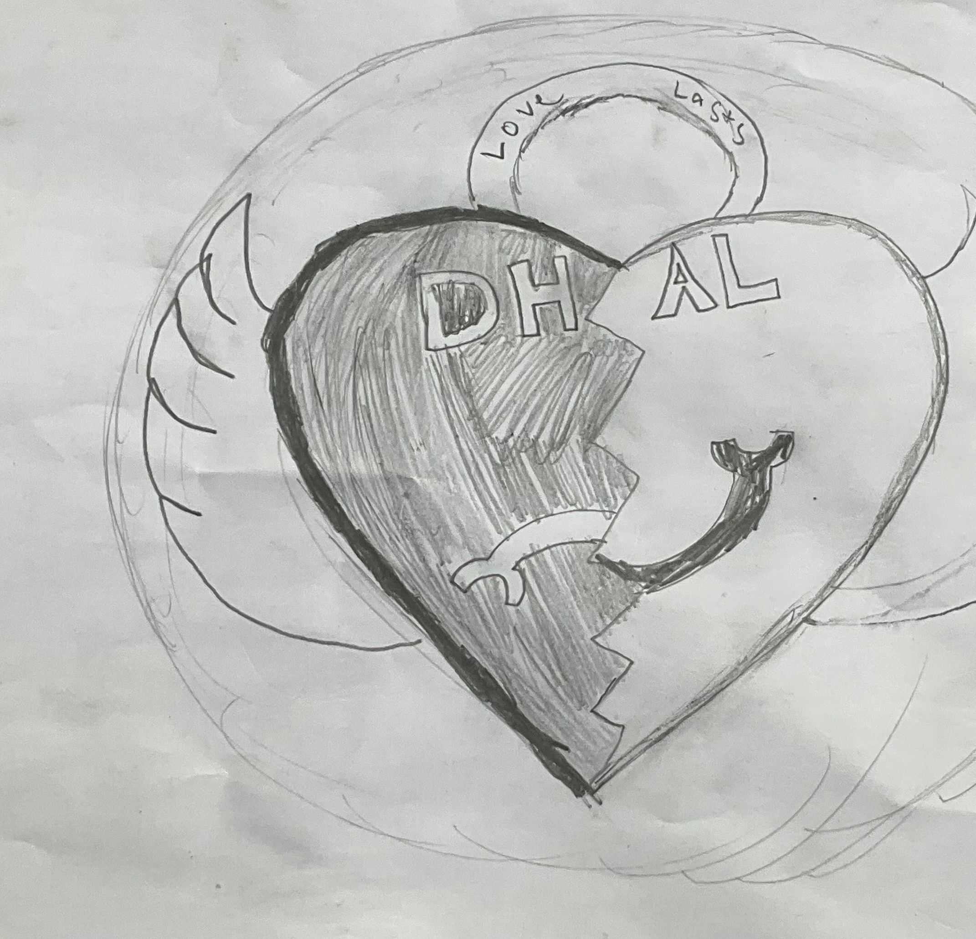
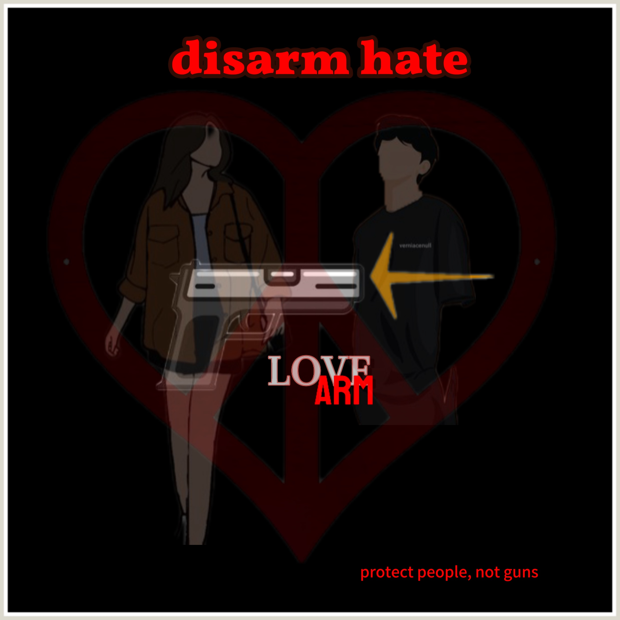
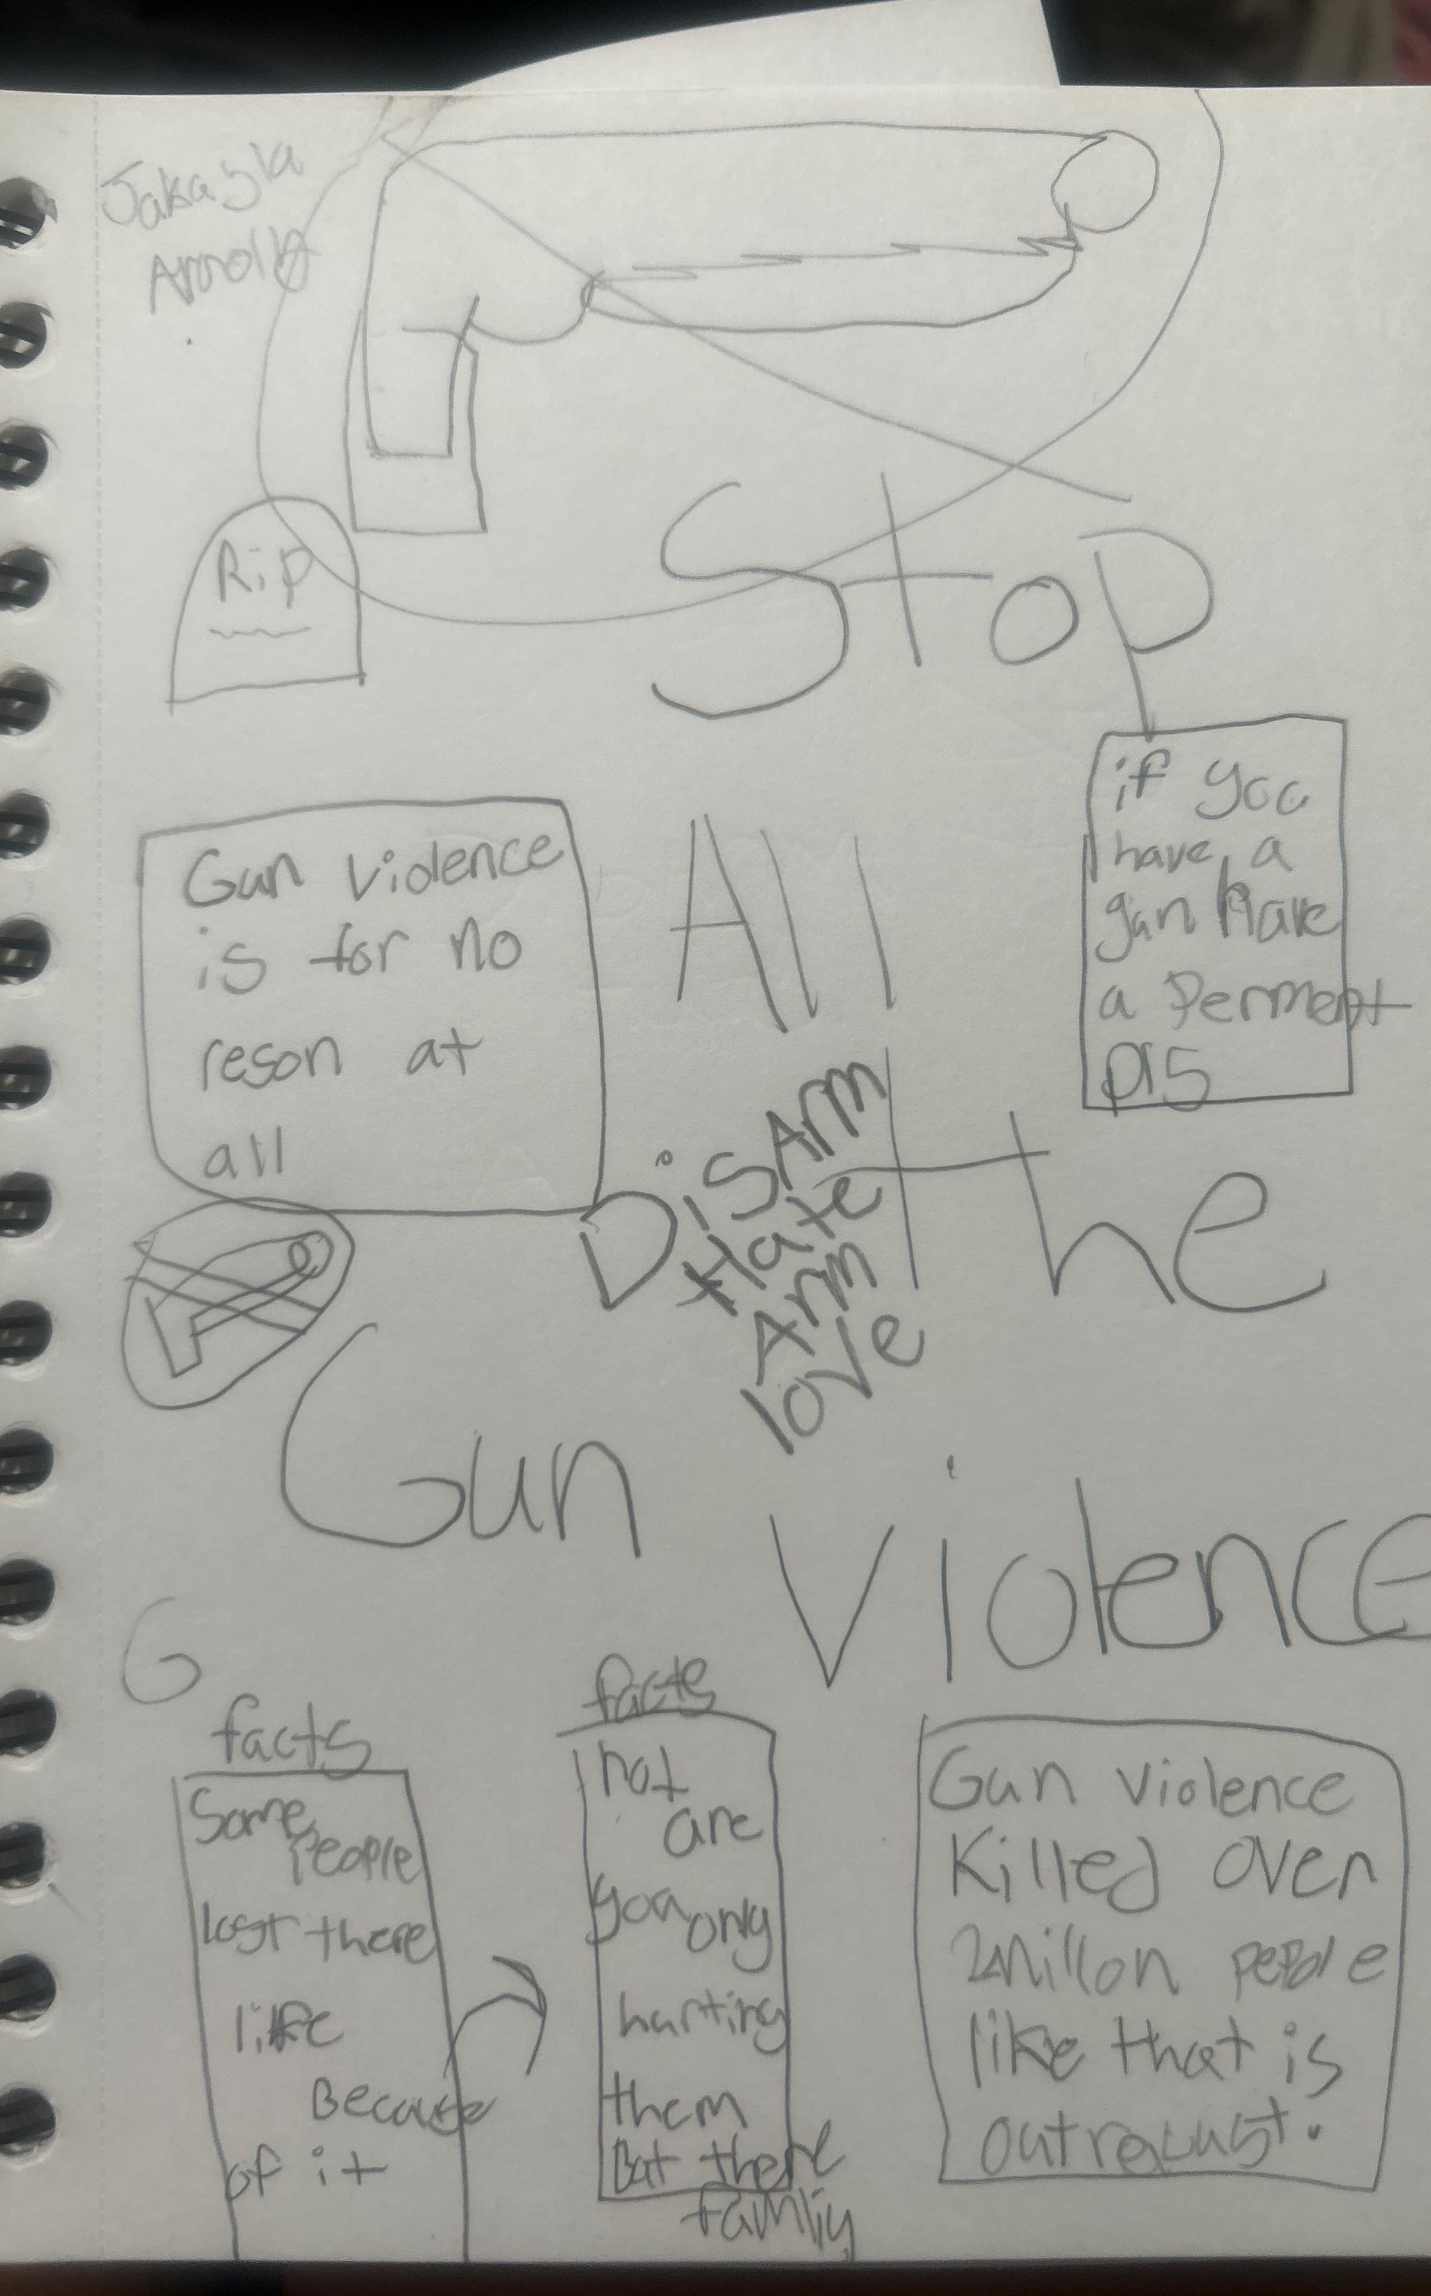
Youth Logo Competition

Slide 7
“Blooming Bullets”
Artist: Heather Stutz
Age: 18
Student at Butler

Slide 8
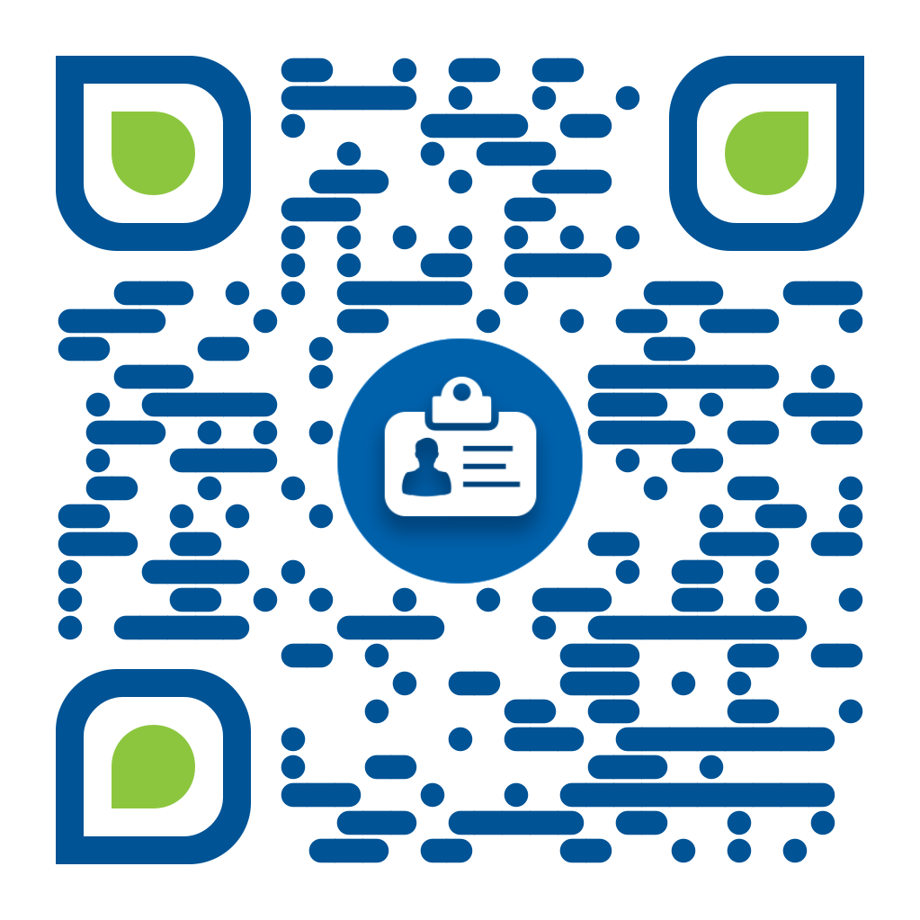
Provider Directory review

Slide 9
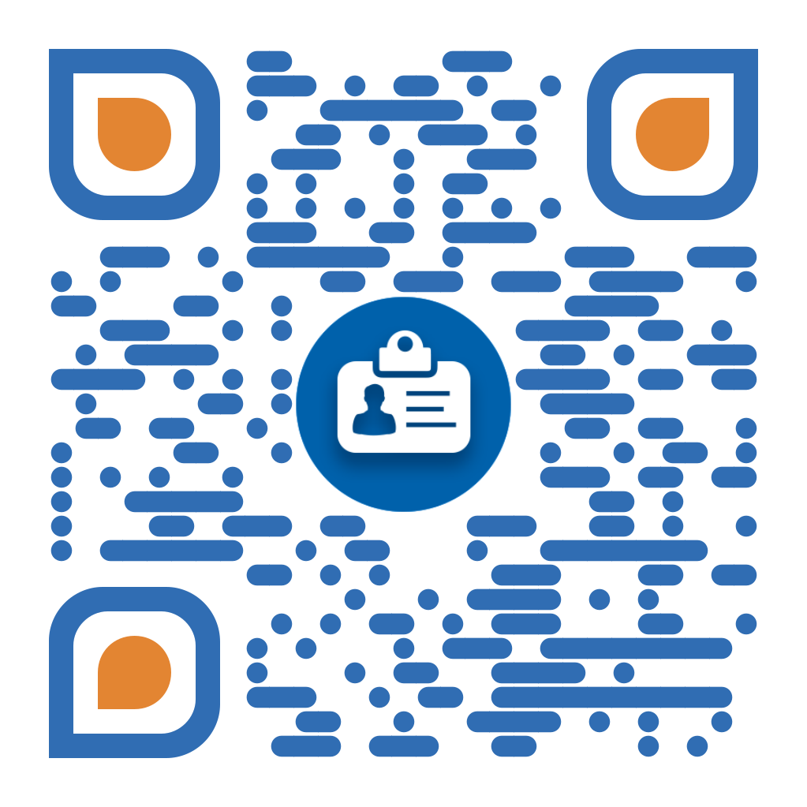
Public Resource Directory

Slide 10
Roundtable Discussion
Please scan the QR code with your phone
Discuss the questions in the survey amongst your tables
Input feedback into the survey

Slide 12
Open Floor for Feedback

Slide 13
Health First Indiana Funding

Slide 15
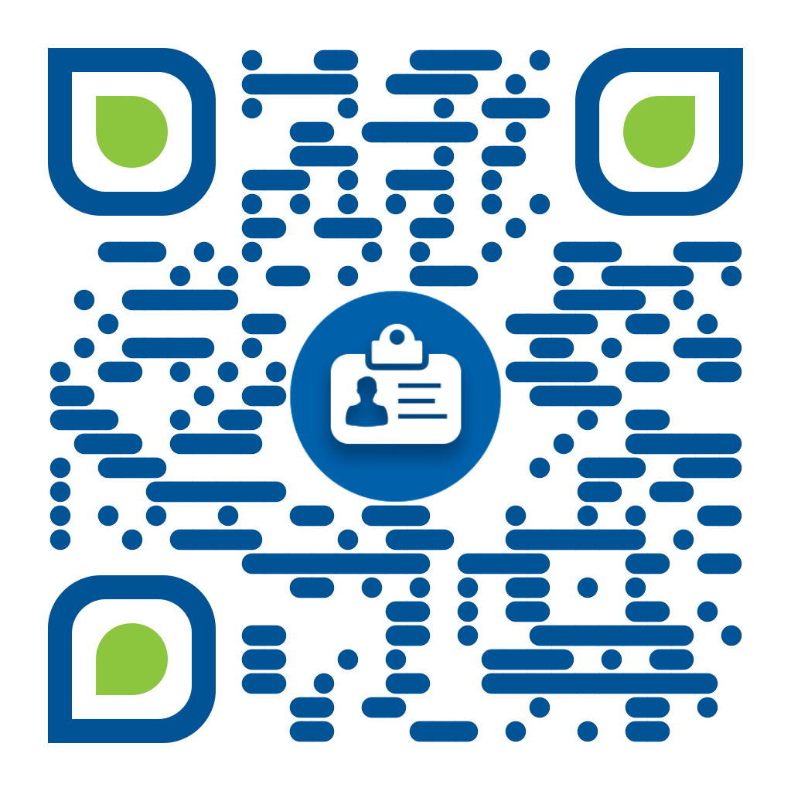
To Do List
1. Complete Community Resource Directory Feedback Form
Look through website on your own
Give feedback for improvements
Community Resource Directory
Feedback Form

Slide 16
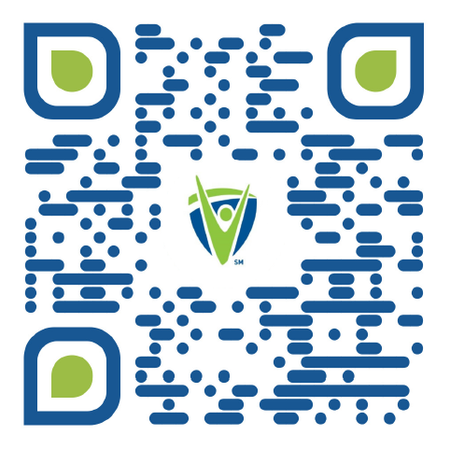
To Do List
2. If Your Organization is Not Listed or
You Need to Update Your Listing,
Complete the Provider Directory Survey
Digitally - scan QR code
Need an interview to complete the survey? Connect with Consuela Flores, Director of Community & Economic Development
consuela.flores@techserv.io
Share survey with partners
3. Be on the Lookout for Published Website Advertisement Email

